Slide 1
Data science

Slide 2
What is data science?
The term Data Science has emerged recently with the evolution of mathematical statistics and data analysis.
It is also known as data driven science, which makes use of scientific methods, processes and systems to extract knowledge or insights from data in various forms, i.e either structured or unstructured.

Slide 3
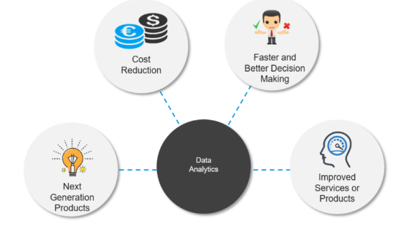
Why data science?

Slide 4
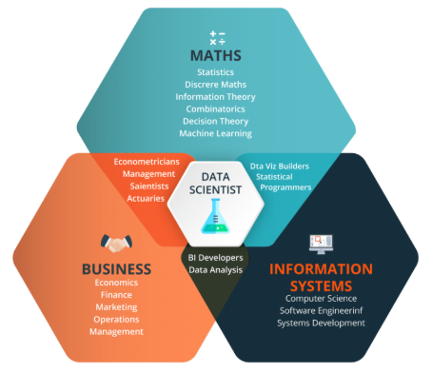
Who is data scientist?

Slide 5
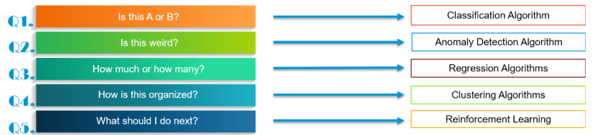
How to solve a problem in data science?
Basically there are 5 kinds of problems which you can face in data science.

